Slide 1

Instruction Fetch Unit (Finite State Machine for implementing
Intro to Computer Architecture Section 50
Cleveland State University
Submitted to : Dr . Sanchita Mal-Sarkar
Submitted By: Pavuluru Anil

Slide 2
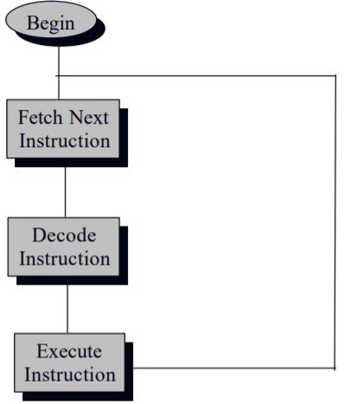
Introduction:
The instruction unit (IU), also called instruction fetch unit (IFU) or instruction issue unit (ISU), in a Central Processing Unit (CPU) is responsible for organizing program instructions to be fetched from memory, and executed, in an appropriate order. It is a part of the Control Unit, which in turn is part of the CPU.
Operations:
The PC is passed through the ALU and incremented.
The PC is used to fetch the next byte in the instruction stream.
Operands are read from memory.
Operands are written to memory.
The ALU does a computation and the results are stored back.

Slide 3
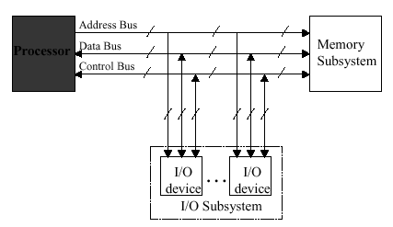
Processor-Memory Interconnection:
In a microcomputer system the processor is connected to main memory by a data, address and control bus
A program consists of a series of instructions or actions to be carried out by the processor. These actions are performed on data.

Slide 4
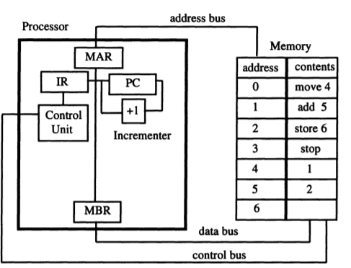
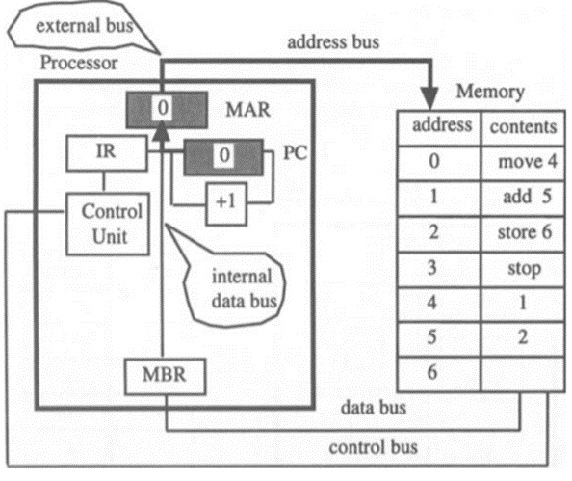
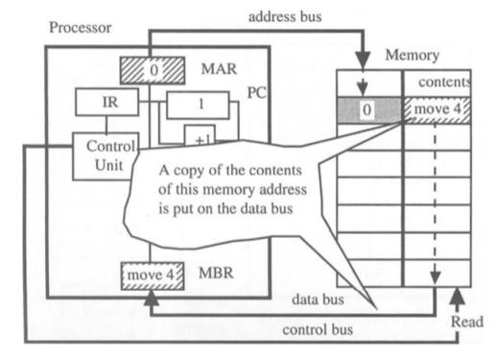
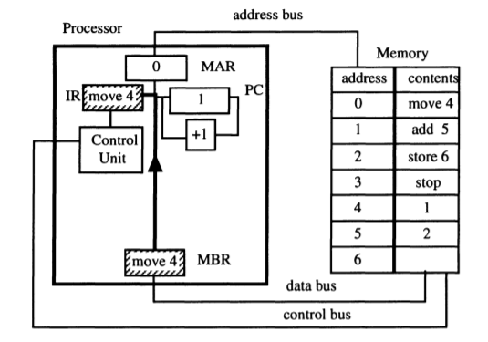
Fetching Instructions:
MAR,MBR,IC and Pc Registers [MAR]← [PC]
operation [MBR] ← [M([MAR])] Move 4 being Transferred into the IR register

Slide 5
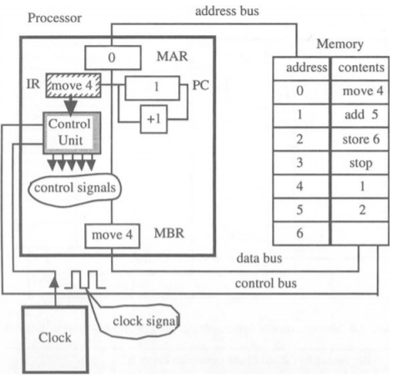
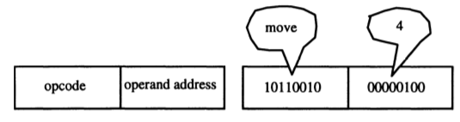
move4 instruction being decoded
Instruction Format:
1)Machine instructions←
2)Assembly Language Instructions

Slide 6
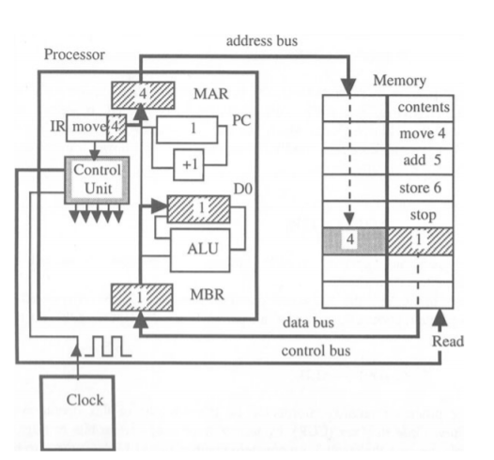
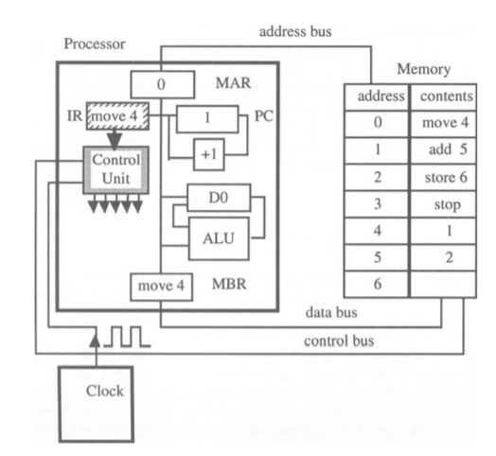
Executing Instructions: 1)Executing Move 4:
showing ALU and data register The three steps involved when executing move 4
1. [MAR] ← [IR(operand address)]
2. [MBR] ← [M(4)]
3. [DO] ← [MBR]

Slide 7
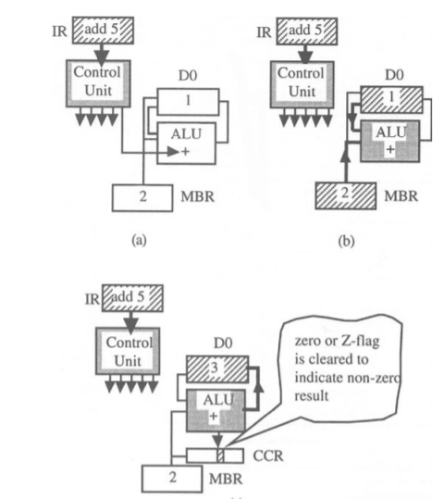
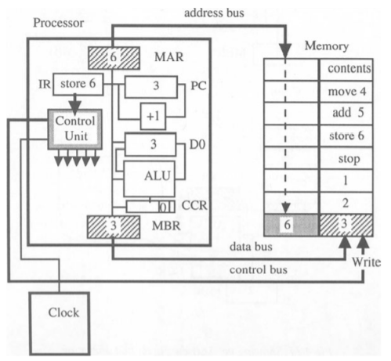
2)Executing add 5: 3)Executing Store 6
©
c
showing memory write operation
1. [MAR] ← [IR(operand address)] 1. [MAR] ← [IR(operand address)]
2. [MBR] ← [M(5)] 2. [MBR] ←[DO]
3. ALU ← [DO] 3. [M(6)] ← [MBR]
ALU ← [MBR]
4. [DO] ← ALU
THANK YOU

